Slide 1

Digital Image Processing, 3rd ed.
Chapter 3
Intensity Transformations and Spatial Filtering
Dept. Computer Science & Engineering
Hongtao Lu
9/19/2017

Slide 2
It makes all the difference whether one sees darkness through the light or brightness through the shadows.
- David Lindsay

Slide 3
Outline
3.1 Background
3.2 Some Basic Intensity Transformations Functions
3.3 Histogram Processing
3.4 Fundamentals of Spatial Filtering
3.5 Smoothing Spatial Filters
3.6 Sharpening Spatial Filters
3.7 Combining Spatial Enhancement Methods
3.8 Using Fuzzy Techniques for Intensity Transformations and Spatial Filtering

Slide 4
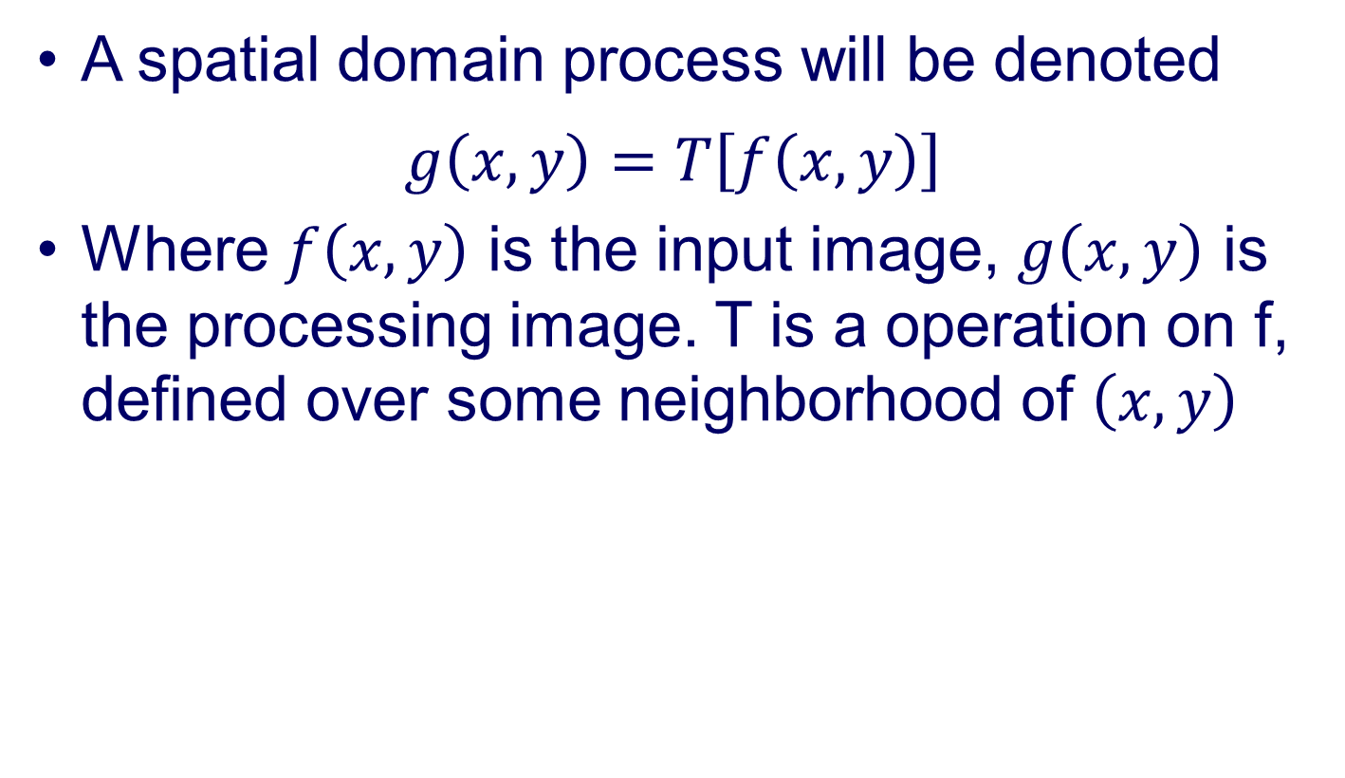
3.1 Background
A spatial domain process will be denoted
$$g\left(x,y\right)=T\left[f\left(x,y\right)\right]$$
Where $f\left(x,y\right)$ is the input image, $g\left(x,y\right)$ is the processing image. T is a operation on f, defined over some neighborhood of $\left(x,y\right)$

Slide 5
3.1 Background
Enhancement based on the mask is referred to as mask processing or filtering
Figure 3.1 A 3X3 neighborhood about a point (𝑥,𝑦) in an image in the spatial domain. The neighborhood is moved from pixel to pixel in the image to generate an output image

Slide 6
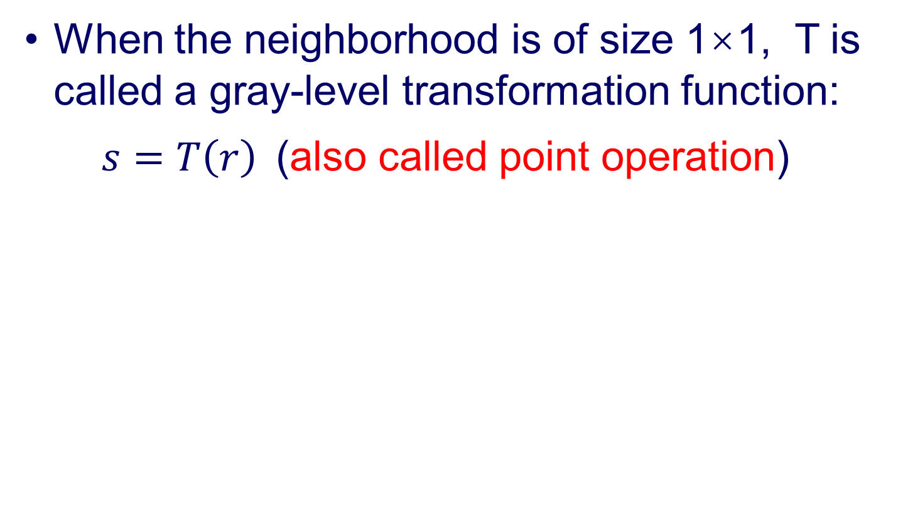
3.1 Background
When the neighborhood is of size 1×1, T is called a gray-level transformation function:
$s=T\left(r\right)$(also called point operation)
Figure 3.2 Intensity transformation functions.
(a) Contrast-stretching function.
(b) Thresholding function.

Slide 7
3.2 Some Basic Gray Level Transformations
3.2.1 Image Negatives
3.2.2 Log Transformations
3.2.3 Power-Law (Gamma) Transformations
3.2.4 Piecewise-Linear Transformation Functions

Slide 8
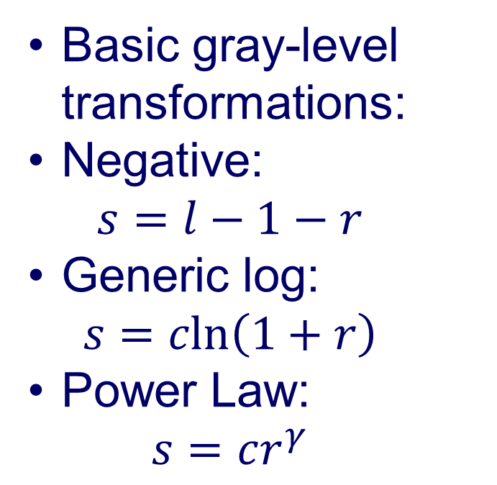
3.2 Some Basic Gray Level Transformations
Basic gray-level transformations:
Negative:
$$s=l−1−r$$
Generic log:
$$s=cln\left(1+r\right)$$
Power Law:
$$s=cr^{γ}$$
Figure 3.3 Some basic intensity transformation functions. All curves were scaled to fit in the range shown.

Slide 9
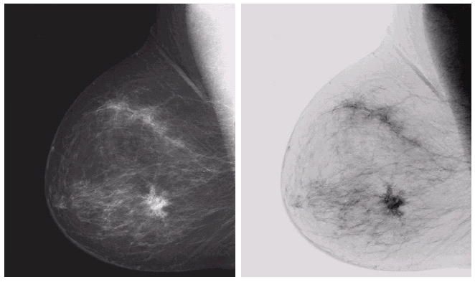
3.2.1 Image Negatives
a b
Figure 3.4 (a) Original digital mammogram. (b) Negative image obtained using the negative transformation in Eq.(3.2-1). (Courtesy of G.E. Medical Systems.)

Slide 10
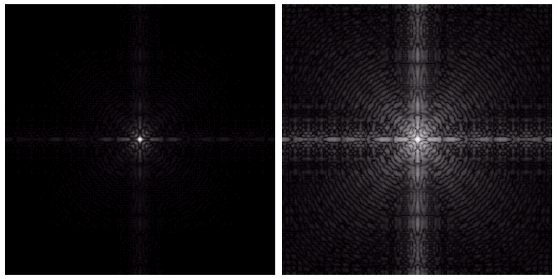
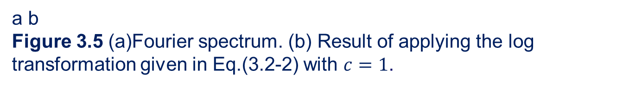

3.2.2 Log Transformation
$$s=cln\left(1+r\right)$$
a b
Figure 3.5 (a)Fourier spectrum. (b) Result of applying the log transformation given in Eq.(3.2-2) with $c=1$.

Slide 11
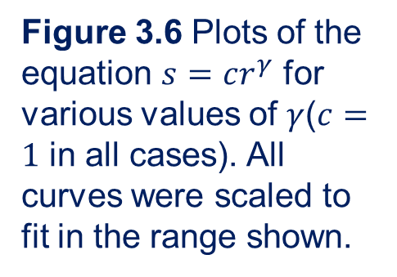
3.2.3 Power-Law (Gamma) Transformation
Figure 3.6 Plots of the equation $s=cr^{γ}$ for various values of $γ$($c=1$ in all cases). All curves were scaled to fit in the range shown.

Slide 12
3.2.3 Power-Law (Gamma) Transformation
a b
c d
Figure 3.7 (a) Intensity ramp image.
(b) Image as viewed on a simulated monitor with a gamma of 2.5.
(c) Gamma-corrected wedge.
(d) Corrected image as viewed on the same monitor. Compare (d) and (a).
Gamma;
Gamma correction.
For CRT, gamma=1.8~2.5

Slide 13
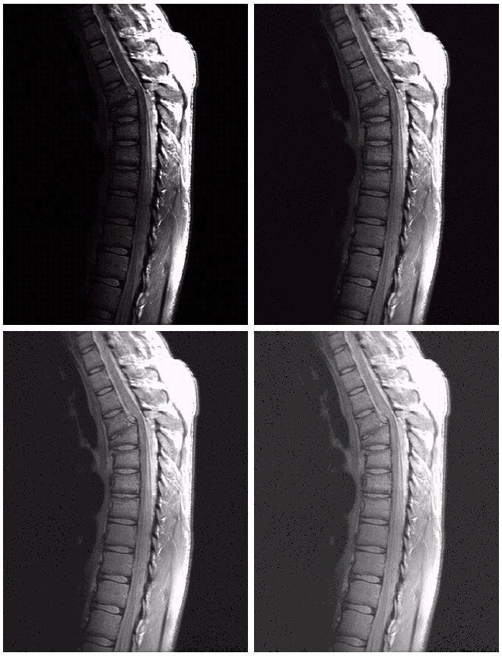
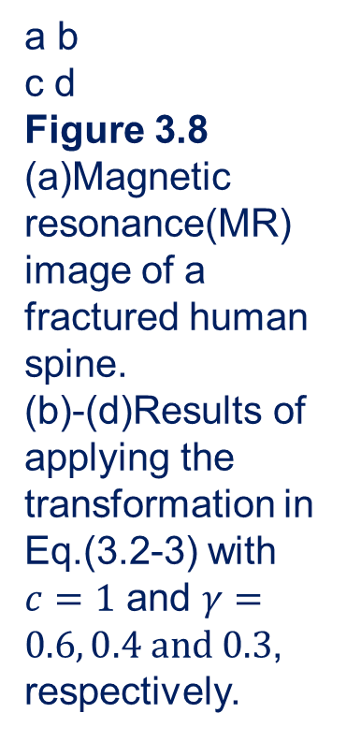
3.2.3 Power-Law (Gamma) Transformation
a b
c d
Figure 3.8
(a)Magnetic resonance(MR) image of a fractured human spine.
(b)-(d)Results of applying the transformation in Eq.(3.2-3) with $c=1$ and $γ=0.6, 0.4 and 0.3$, respectively.
Contrast enhancement using power-law transformation

Slide 14
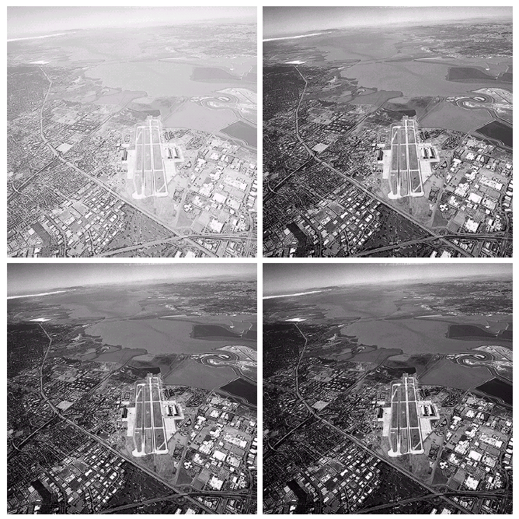
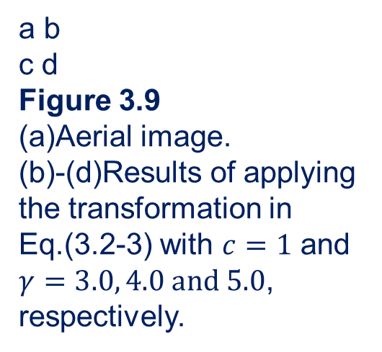
3.2.3 Power-Law (Gamma) Transformation
Another illustration of power-lar transformations.
a b
c d
Figure 3.9
(a)Aerial image.
(b)-(d)Results of applying the transformation in Eq.(3.2-3) with $c=1$ and $γ=3.0, 4.0 and 5.0$, respectively.

Slide 15
3.2.4 Piecewise-Linear Transformation Functions
a b
c d
Figure 3.10 Contrast stretching.
(a) Form of transformation function. (b) A low-contrast image. (c) Result of contrast stretching.
(d) Result of thresholding.
Contrast Stretching

Slide 16
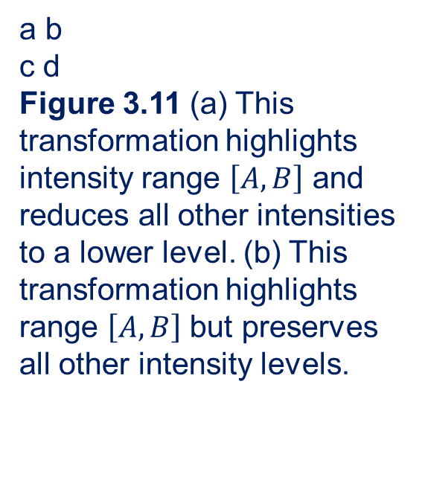
3.2.4 Piecewise-Linear Transformation Functions
Gray-level slicing
a b
c d
Figure 3.11 (a) This transformation highlights intensity range $\left[A, B\right]$ and reduces all other intensities to a lower level. (b) This transformation highlights range $\left[A, B\right]$but preserves all other intensity levels.

Slide 17
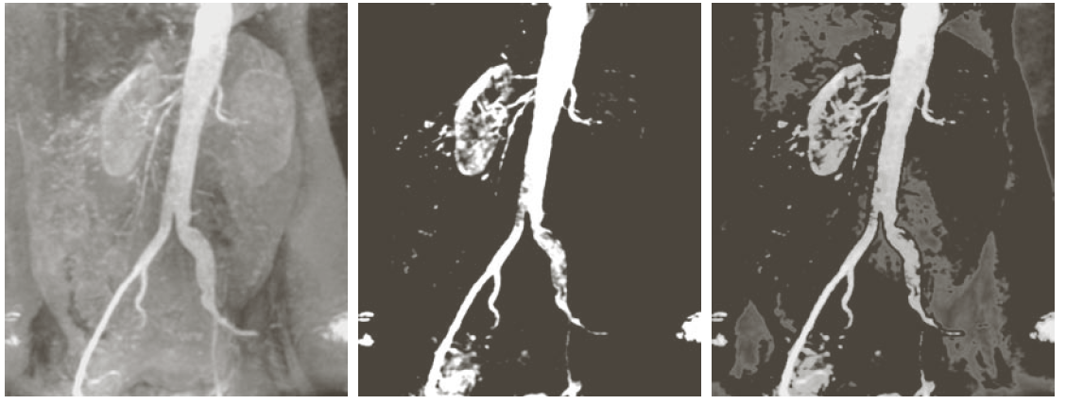
3.2.4 Piecewise-Linear Transformation Functions
a b c
Figure 3.12 (a) Aortic angiogram. (b) Result of using a slicing transformation of the type illustrated in Fig. 3.11(a), with the range of intensities of interest selected in the upper end of the gray scale. (c) Result of using the transformation in Fig. 3.11(b), with the selected area set to black, so that grays in the area of the blood vessels and kidneys were preserved.

Slide 18
3.2.4 Piecewise-Linear Transformation Functions
Bit-plane slicing
Figure 3.13 Bit-plane representation of an 8-bit image.

Slide 19
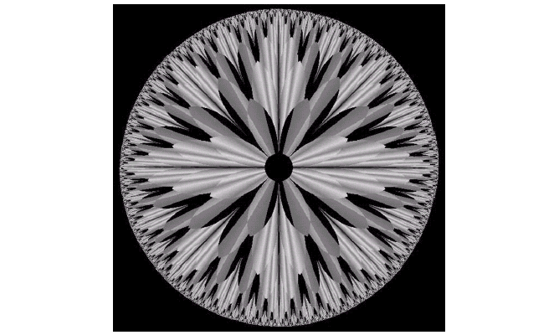
3.2.4 Piecewise-Linear Transformation Functions
Figure 3.13(DIP 2nd Edition) An 8-bit fractal image. (A fractal is an image generated from mathematical expressions)

Slide 20
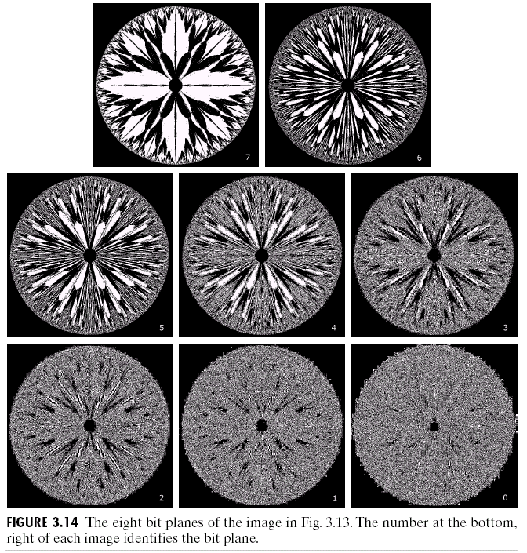
3.2.4 Piecewise-Linear Transformation Functions
8 bit planes
Figure 3.14(DIP 2nd Edition) The eight bit planes of the image in Fig. 3.13. The number at the bottom, right of each image identifies the bit plane.

Slide 21
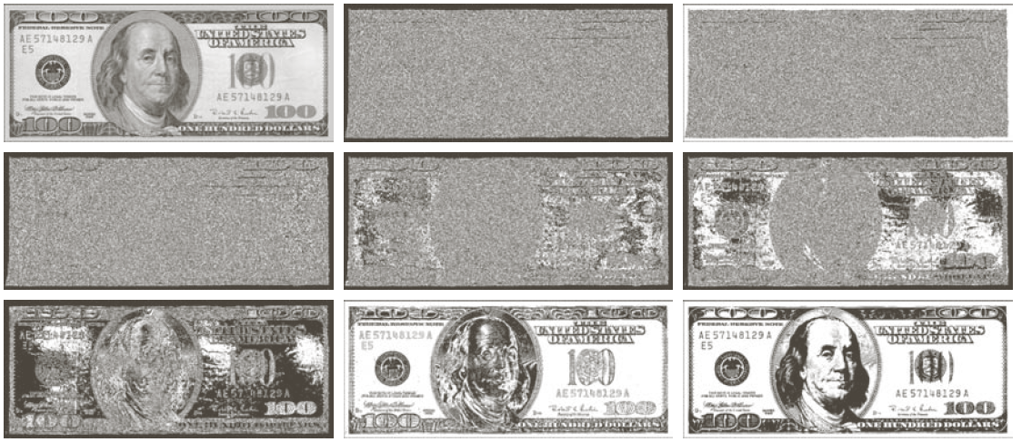
3.2.4 Piecewise-Linear Transformation Functions
a b c
d e f
g h i
Figure 3.14 (a) An 8-bit gray-scale image of size 500X1192 pixels. (b) through (i) Bit planes 1 through 8, with bit plane 1 corresponding to the least significant bit. Each bit plane is a binary image.

Slide 22
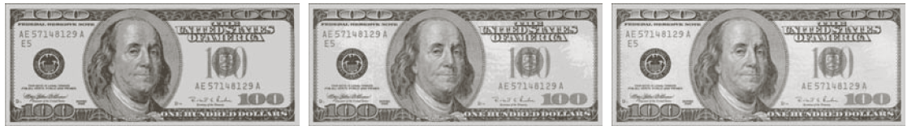
3.2.4 Piecewise-Linear Transformation Functions
a b c
Figure 3.15 Images reconstructed using (a) bit planes 8 and 7; (b) bit planes 8, 7 and 6; and (c) bit planes 8, 7, 6 and 5. Compare (c) with Fig. 3.14(a).

Slide 23
3.3 Histogram Processing
3.3.1 Histogram Equalization
3.3.2 Histogram Matching (Specification)
3.3.3 Local Histogram Processing
3.3.4 Use of Histogram Statistics for Image Enhancement

Slide 24
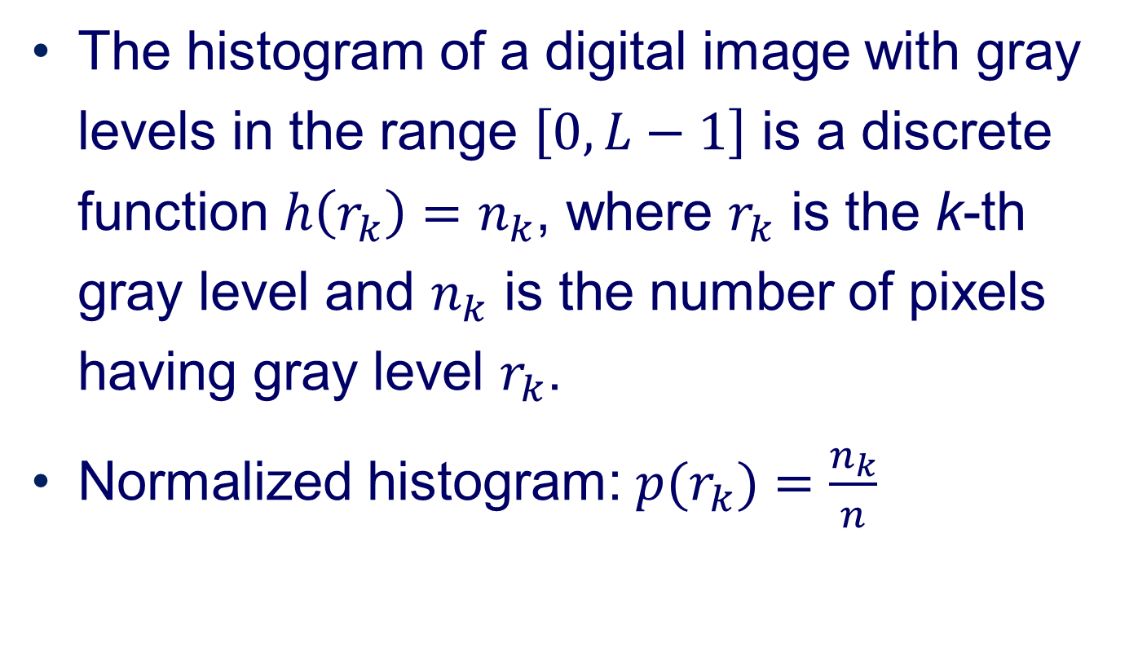
3.3 Histogram Processing
The histogram of a digital image with gray levels in the range $\left[0, L−1\right]$ is a discrete function $h\left(r_{k}\right)=n_{k}$, where $r_{k}$ is the k-thgray level and $n_{k}$ is the number of pixels having gray level $r_{k}$.
Normalized histogram: $p(r_{k})=\frac{n_{k}}{n}$

Slide 25
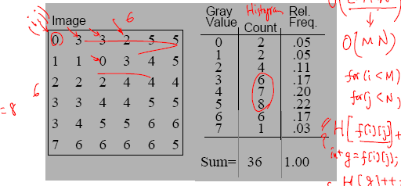
3.3 Histogram Processing
The image shows the spatial distribution of gray values.
The image histogram discards the spatial information and shows the relative frequency of occurrence of the gray values.

Slide 26
3.3 Histogram Processing
Lenna.
Histogram of Lenna.

Slide 27
3.3 Histogram Processing
Four basic image types and their histogram
a b
Figure 3.16 Four basic image types: dark, light, low contrast, high contrast, and their corresponding histograms.

Slide 28
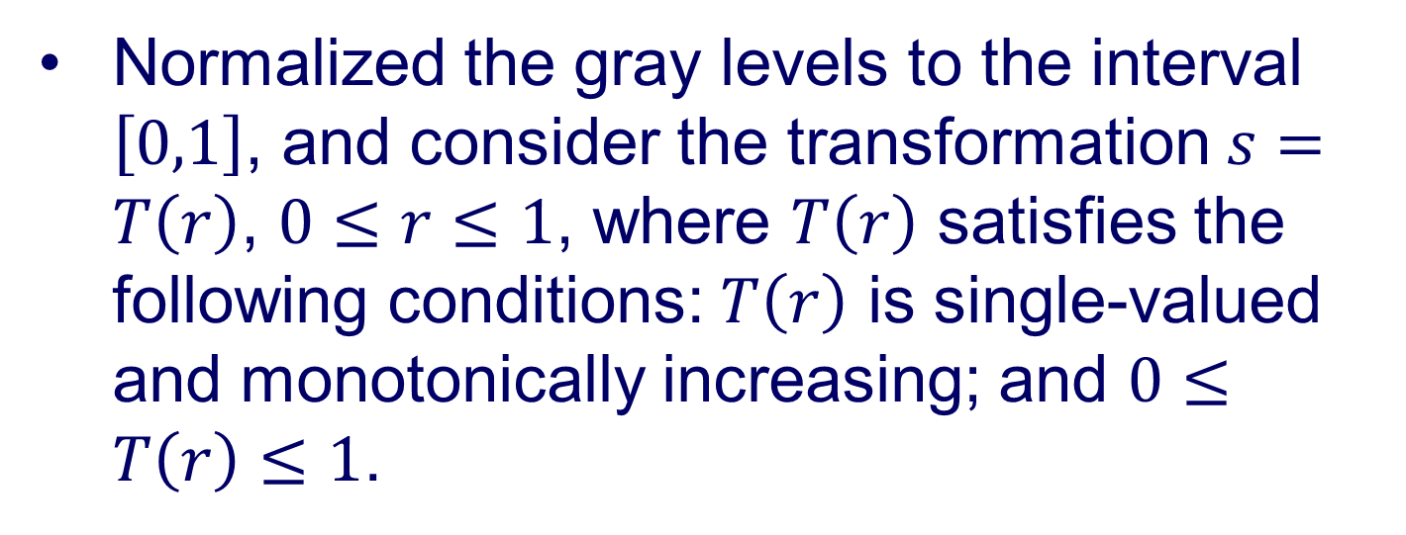
3.3.1 Histogram Equalization
Normalized the gray levels to the interval $\left[0,1\right]$, and consider the transformation $s=T\left(r\right)$, $0≤r≤1$, where $T\left(r\right)$ satisfies the following conditions: $T\left(r\right)$ is single-valued and monotonically increasing; and $0≤T\left(r\right)≤1$.

Slide 29
3.3.1 Histogram Equalization
a b
Figure 3.17 (a) Monotonically increasing function, showing how multiple values can map to a single value. (b) Strictly monotonically increasing function. This is a one-to-one mapping, both ways.

Slide 30
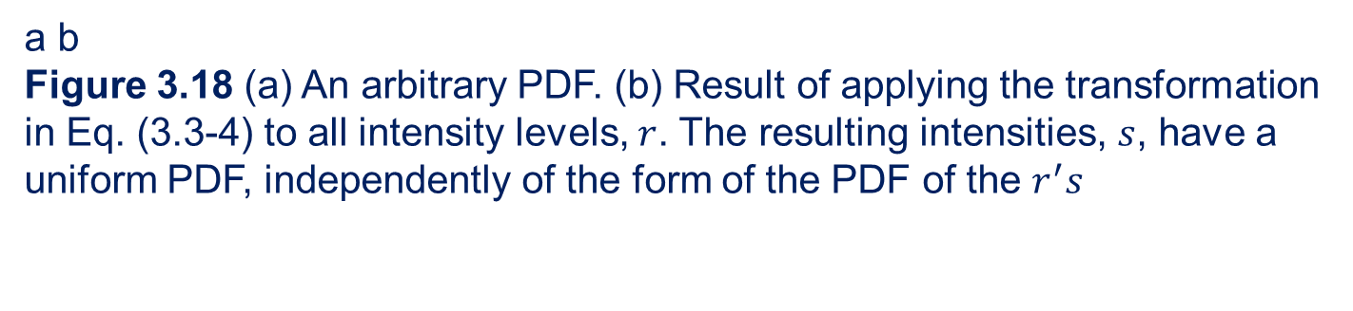
3.3.1 Histogram Equalization
a b
Figure 3.18 (a) An arbitrary PDF. (b) Result of applying the transformation in Eq. (3.3-4) to all intensity levels, $r$. The resulting intensities, $s$, have a uniform PDF, independently of the form of the PDF of the $r^{′}s$

Slide 31
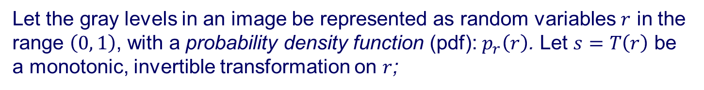
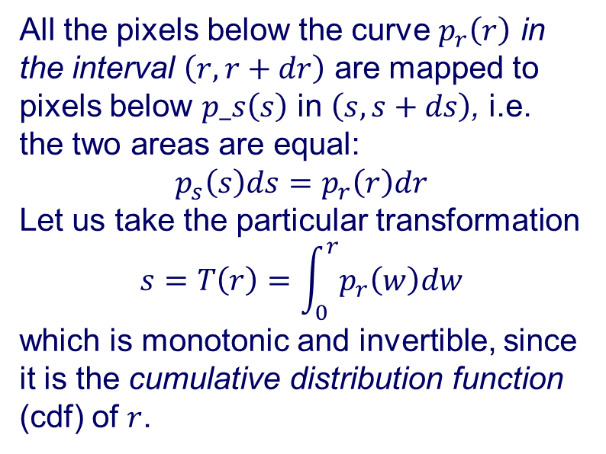
3.3.1 Histogram Equalization
Let the gray levels in an image be represented as random variables $r$ in the range $\left(0, 1\right)$, with a probability density function (pdf): $p_{r}\left(r\right)$. Let $s=T\left(r\right)$be a monotonic, invertible transformation on $r$;
All the pixels below the curve $p_{r}\left(r\right)$ in the interval $\left(r, r+dr\right)$are mapped to pixels below $p_s\left(s\right)$ in $\left(s, s+ds\right)$, i.e. the two areas are equal:
$$p_{s}\left(s\right)ds=p_{r}\left(r\right)dr$$
Let us take the particular transformation
$$s=T\left(r\right)=\int_{0}^{r}{p_{r}\left(w\right)dw}$$
which is monotonic and invertible, since it is the cumulative distribution function (cdf) of $r$.

Slide 32
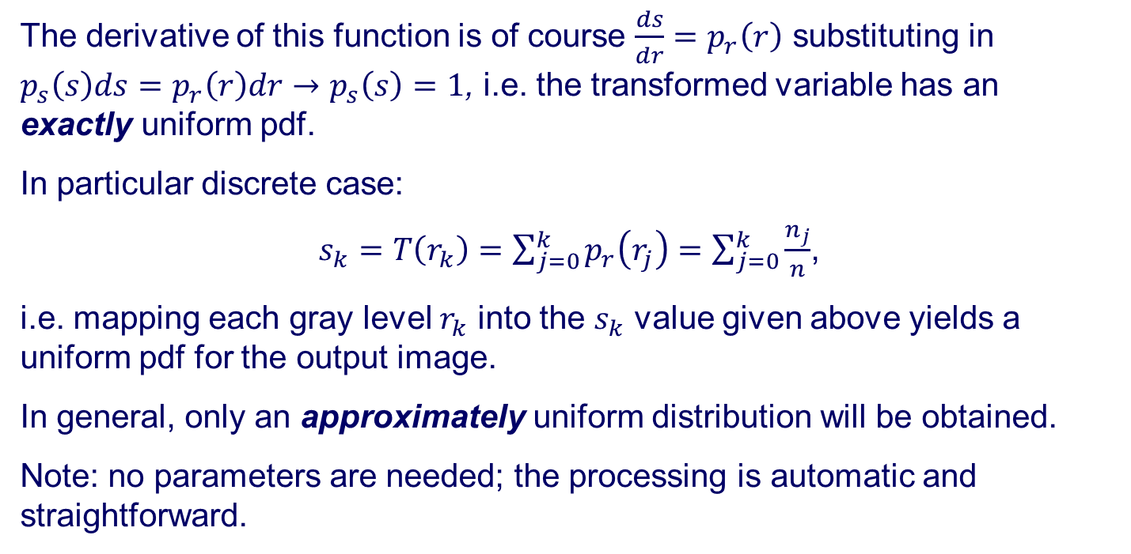
3.3.1 Histogram Equalization
The derivative of this function is of course $\frac{ds}{dr}=p_{r}\left(r\right)$substituting in $p_{s}\left(s\right)ds=p_{r}\left(r\right)dr→p_{s}\left(s\right)=1$, i.e. the transformed variable has an exactly uniform pdf.
In particular discrete case:
$s_{k}=T\left(r_{k}\right)=\sum_{j=0}^{k}{p_{r}\left(r_{j}\right)=\sum_{j=0}^{k}{\frac{n_{j}}{n}}}$,
i.e. mapping each gray level $r_{k}$ into the $s_{k}$ value given above yields a uniform pdf for the output image.
In general, only an approximately uniform distribution will be obtained.
Note: no parameters are needed; the processing is automatic and straightforward.

Slide 33
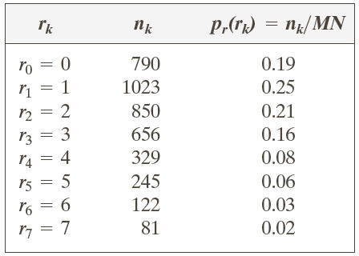
3.3.1 Histogram Equalization
Table 3.1 Intensity distribution and histogram values of a 3-bit, 64X64 digital image.

Slide 34
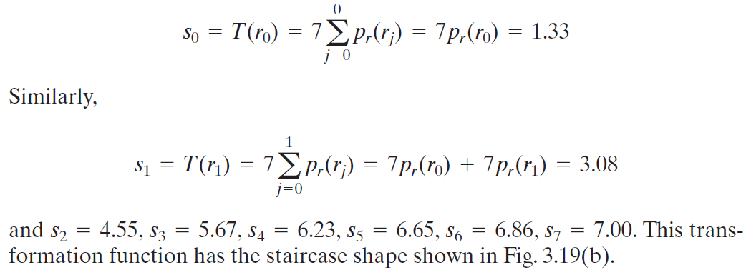
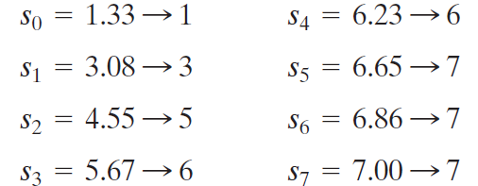

Slide 35
3.3.1 Histogram Equalization
a b c
Figure 3.19 Illustration of histogram equalization of a 3-bit (8 intensity levels) image. (a) Original histogram. (b) Transformation function. (c) Equalized histogram.

Slide 36
3.3.1 Histogram Equalization
Example of Histogram Equalization
Figure 3.20 Left column: images from Fig. 3.16. Center column: corresponding histogram-equalized images. Right column: histograms of the images in the center column.

Slide 37
3.3.1 Histogram Equalization
Transformation functions
Figure 3.21 Transformation functions for histogram equalization. Transformations (1) through (4) were obtained from the histograms of the images (from top to bottom) in the left column of Fig. 3.20 using Eq. (3.3-8).

Slide 38
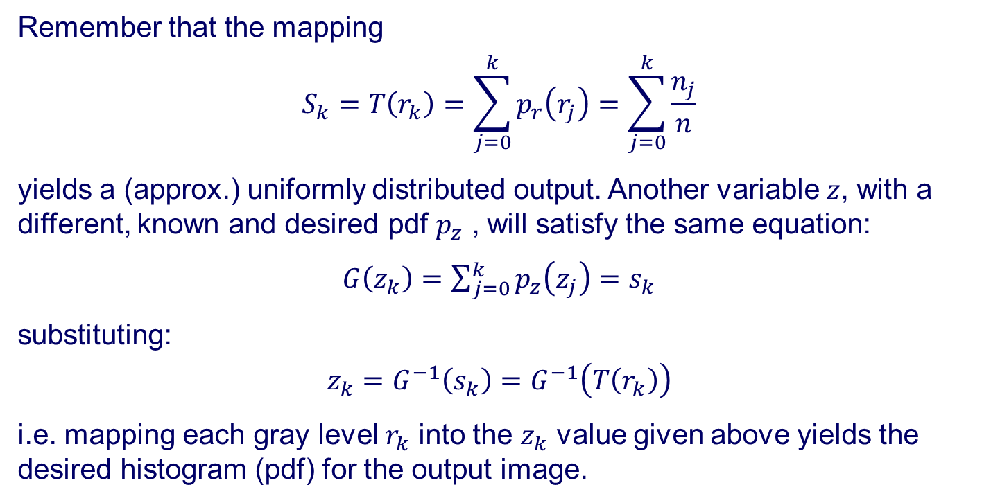
3.3.2 Histogram Matching (Specification)
Remember that the mapping
$$S_{k}=T\left(r_{k}\right)=\sum_{j=0}^{k}{p_{r}\left(r_{j}\right)=\sum_{j=0}^{k}{\frac{n_{j}}{n}}}$$
yields a (approx.) uniformly distributed output. Another variable $z$, with a different, known and desired pdf $p_{z}$ , will satisfy the same equation:
$G\left(z_{k}\right)=\sum_{j=0}^{k}{p_{z}\left(z_{j}\right)}=s_{k}$
substituting:
$$z_{k}=G^{−1}\left(s_{k}\right)=G^{−1}\left(T\left(r_{k}\right)\right)$$
i.e. mapping each gray level $r_{k}$ into the $z_{k}$ value given above yields the desired histogram (pdf) for the output image.

Slide 39
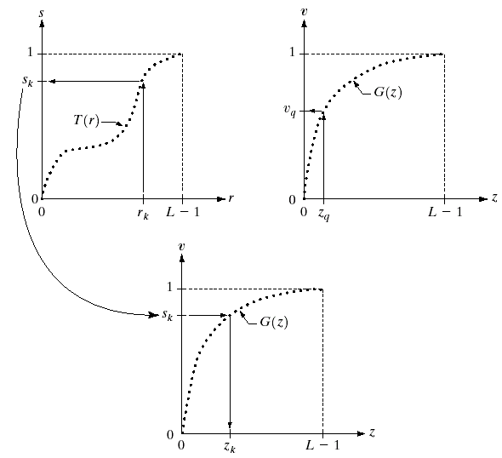
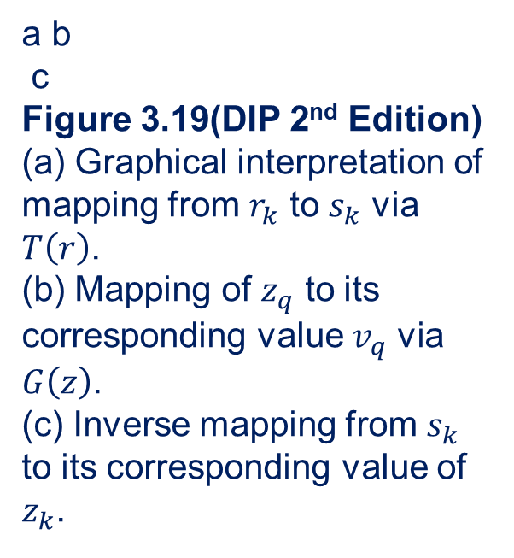
3.3.2 Histogram Matching (Specification)
Graphical interpretation of histogram matching
a b
c
Figure 3.19(DIP 2nd Edition)
(a) Graphical interpretation of mapping from $r_{k}$ to $s_{k}$ via $T\left(r\right)$.
(b) Mapping of $z_{q}$ to its corresponding value $v_{q}$ via $G\left(z\right)$.
(c) Inverse mapping from $s_{k}$ to its corresponding value of $z_{k}$.

Slide 40
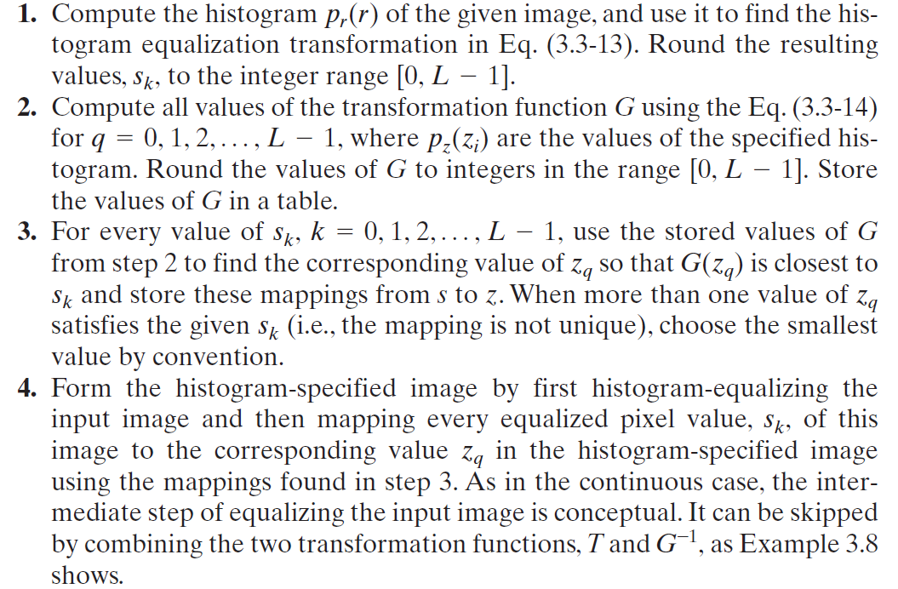

Slide 41
3.3.2 Histogram Matching (Specification)
a b
c d
Figure 3.22
(a) Histogram of a 3-bit image.
(b) Specified histogram.
(c) Transformation function obtained from the specified histogram.
(d) Result of performing histogram specification.
Compare (b) and (d)

Slide 42
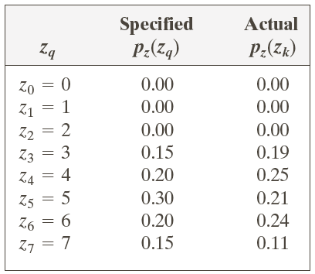
3.3.2 Histogram Matching (Specification)
Table 3.2 Specified and actual histograms (the values in the third column are from the computations performed in the body of Example 3.8).

Slide 43
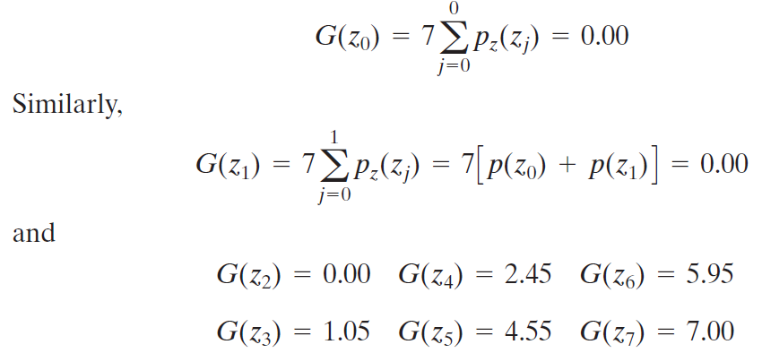
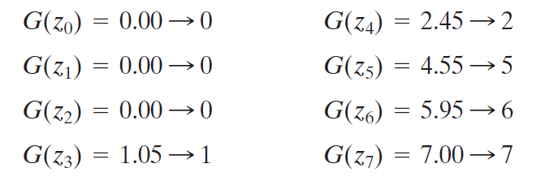

Slide 44
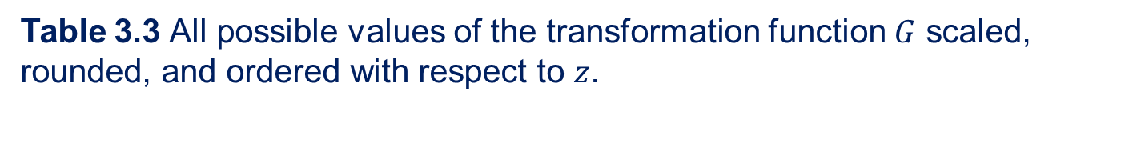
3.3.2 Histogram Matching (Specification)
Table 3.3 All possible values of the transformation function $G$ scaled, rounded, and ordered with respect to $z$.

Slide 45
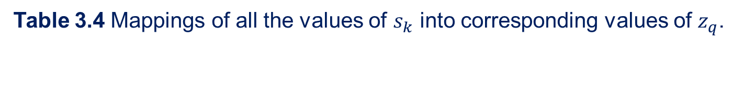
3.3.2 Histogram Matching (Specification)
Table 3.4 Mappings of all the values of $s_{k}$ into corresponding values of $z_{q}$.

Slide 46
3.3.2 Histogram Matching (Specification)
a b
Figure 3.23
(a) Image of the Mars moon Photos taken by NASA’s Mars Global Surveyor. (b) Histogram. (Original image courtesy of NASA.)

Slide 47
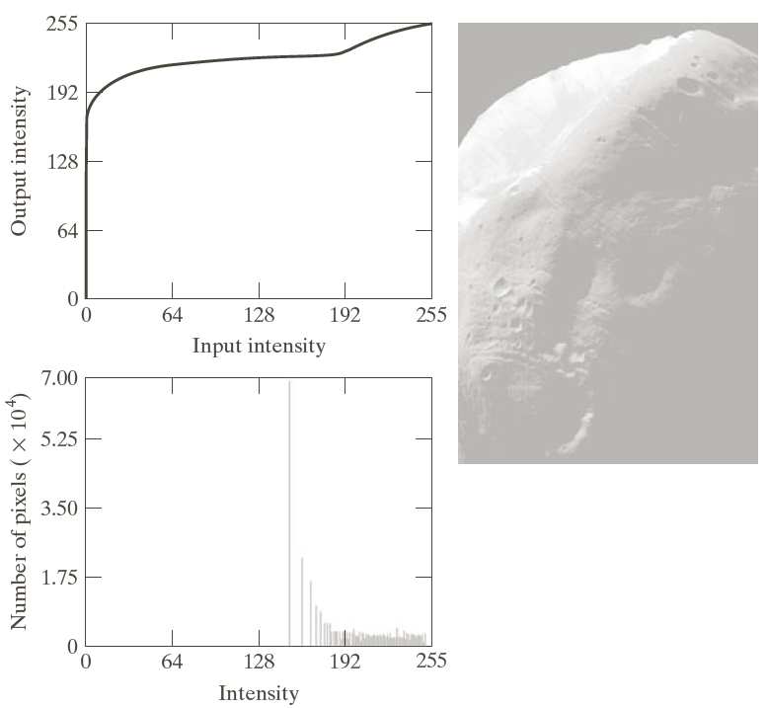
3.3.2 Histogram Matching (Specification)
a b
c
Figure 3.24
(a) Transformation function for histogram equalization.
(b) Histogram-equalized image (note the washed-out appearance).
(c) Histogram of (b).

Slide 48
3.3.2 Histogram Matching (Specification)
a c
b
d
Figure 3.25
(a) Specified histogram.
(b) Transformations.
(c) Enhanced image using mappings from curve (2).
(d) Histogram of (c).

Slide 49
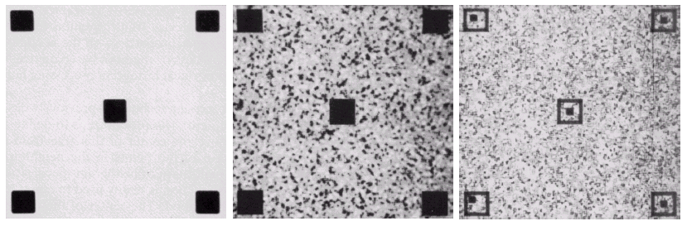
3.3.3 Local Histogram Processing
a b c
Figure 3.23(DIP 2nd Edition)
(a) Original image. (b) Result of global histogram equalization. (c) Result of local histogram equalization using a 7X7 neighborhood about each pixel.

Slide 50
3.3.3 Local Histogram Processing
a b c
Figure 3.26
(a) Original image. (b) Result of global histogram equalization. (c) Result of local histogram equalization applied to (a), using a neighborhood of size 3X3.

Slide 51
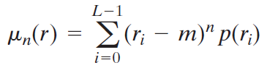
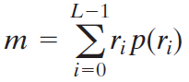
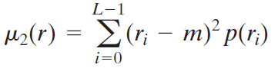
3.3.3 Use of Histogram Statistics for Image Enhancement
The nth moment
Mean (average intensity)
Variance

Slide 52
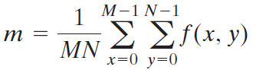
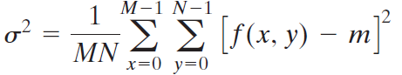
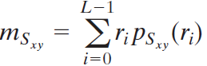
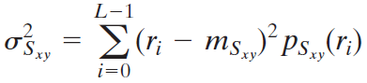
Sample mean and Sample variance
Local mean and local variance

Slide 53
3.3.3 Use of Histogram Statistics for Image Enhancement
a b c
Figure 3.27
(a) SEM image of a tungsten filament and support, magnified approximately 130X. (b) Result of global histogram equalization. (c) Image Enhanced using local histogram statistics.

Slide 54
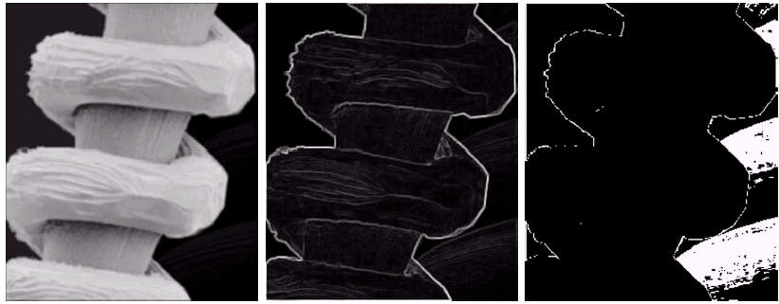
3.3.3 Use of Histogram Statistics for Image Enhancement
a b c
Figure 3.25(DIP 2nd Edition)
(a) Image formed from all local means obtained from Fig. 3.24 using Eq. (3.3-21). (b) Image formed form all local standard deviations obtained from Fig. 3.24 using Eq. (3.3-22). (c) Image formed from all multiplication constants used to produce the enhanced image shown in Fig. 3.26.

Slide 55
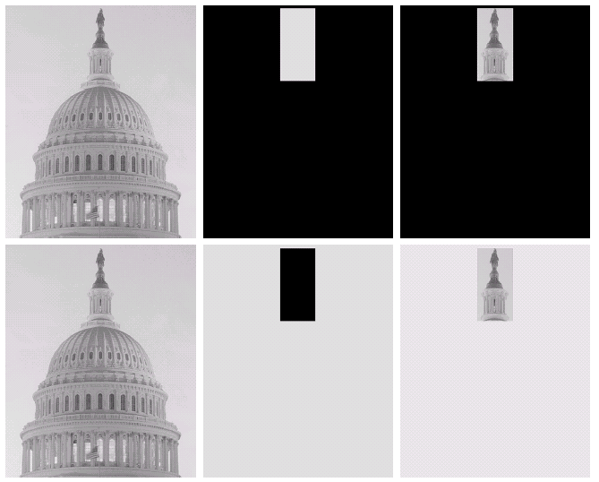
3.3.3 Use of Histogram Statistics for Image Enhancement
a b c
d e f
Figure 3.27(DIP 2nd Edition)
Original image.
(b) AND image mask.
(c) Result of the AND operation on images (a) and (b).
(d) Original image.
(e) OR image mask.
(f) Result of operation OR on images (d) and (e).

Slide 56
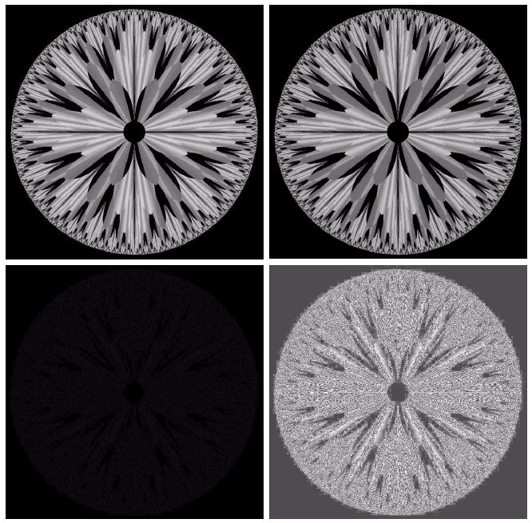
3.3.3 Use of Histogram Statistics for Image Enhancement
a b
c d
Figure 3.28(DIP 2nd Edition)
(a) Original fractal image.
(b) Result of setting the four lower-order bit planes to zero.
(c) Difference between (a) and (b).
(d) Histogram-equalized difference image.

Slide 57
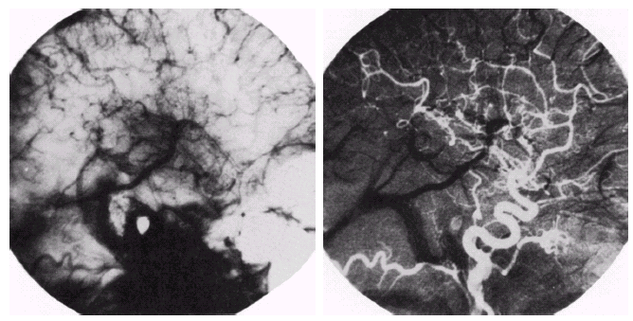
3.3.3 Use of Histogram Statistics for Image Enhancement
a b
Figure 3.29(DIP 2nd Edition)
Enhancement by image subtraction.
(a) Mask image.
(b) An image (taken after injection of a contrast medium into the bloodstream) with mask subtracted out.

Slide 58
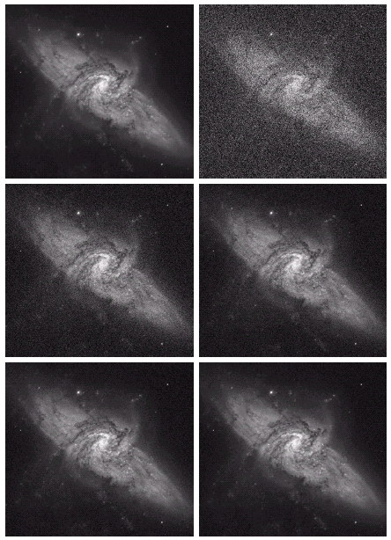

3.3.3 Use of Histogram Statistics for Image Enhancement
a b
c d
e f
Figure 3.30(DIP 2nd Edition)
(a) Image of Galaxy Pair NGC 3314.
(b) Image corrupted by additive Gaussian noise with zero mean and a standard deviation of 64 gray level.
(c)-(f) Results of averaging $K=8,16,64 and 128$ noisy images. (Original image courtesy of NASA.)

Slide 59

3.3.3 Use of Histogram Statistics for Image Enhancement
a b
Figure 3.31(DIP 2nd Edition)
(a) From top to bottom:
Difference images between Fig. 3.30(a) and the four images in Fig. 3.30(c) through (f), respectively.
(b) Corresponding histograms.

Slide 60
3.4 Fundamentals of Spatial Filtering
3.4.1 The Mechanics of Spatial Filtering
3.4.2 Spatial Correlation and Convolution
3.4.3 Vector Representation of Linear Filtering
3.4.4 Generating Spatial Filter Masks

Slide 61


3.4.1 The Mechanics of Spatial Filtering
Figure 3.28
The mechanics of spatial filtering using a 3X3 filter mask. The form chosen to denote the coordinates of the filter mask coefficients simplifies writing expressions for linear filtering.

Slide 62
3.4.2 Spatial Correlation and Convolution
Figure 3.29
Illustration of 1-D correlation and convolution of a filter with a discrete unit impulse. Note that correlation and convolution are functions of displacement.

Slide 63

3.4.2 Spatial Correlation and Convolution
2-D Correlation
$$w\left(x,y\right)\text{☆}f\left(x,y\right)=\sum_{s=−a}^{a}{\sum_{t=−b}^{b}{w\left(s,t\right)f\left(x+s, y+t\right)}}$$
Convolution
$$w\left(x,y\right)\text{★}f\left(x,y\right)=\sum_{s=−a}^{a}{\sum_{t=−b}^{a}{w\left(s,t\right)f\left(x−s, y−t\right)}}$$
Figure 3.30 Correlation (middle row) and convolution (last row) of a 2-D filter with a 2-D discrete, unit impulse. The 0s are shown in gray to simplify visual analysis.

Slide 64


3.4.3 Vector Representation of Linear Filtering
$$R=w_{1}z_{1}+w_{2}z_{2}+⋯+w_{mn}z_{mn}$$
$=w^{T}z$
Figure 3.31
Another representation of a general 3X3 spatial filter mask.

Slide 65
3.5 Smoothing Spatial Filters
3.5.1 Smoothing Linear Filters
3.5.2 Order-Statistic (Nonlinear) Filters

Slide 66


3.5.1 Smoothing Linear Filters
a b
Figure 3.34
Two 3X3 smoothing (averaging) filter masks. The constant multiplier in front of each mask is equal to 1 divided by the sum of the values of its coefficients, as is required to compute an average.
Smoothing Linear Filters
$$R=\frac{1}{9}\sum_{i=1}^{9}{z_{i}}$$
Weighted Averaging Filters
$$g\left(x,y\right)=\frac{\sum_{s=−a}^{a}{\sum_{t=−b}^{b}{w\left(s,t\right)f(x−s,y−t)}}}{\sum_{s=−a}^{a}{\sum_{t=−b}^{b}{w\left(s,t\right)}}}$$

Slide 67

3.5.1 Smoothing Linear Filters
a b
c d
e f
Figure 3.33
(a)Original image, of size 500X500 pixels.
(b)-(f) Results of smoothing with square averaging filter mask of size n=3,5,9,15 and 35, respectively. The black squares at the top are of sizes 3,5,9,15,25,35,45 and 55 pixels, respectively; their borders are 25 pixels apart. The letters at the bottom range in size from 10 to 24 points, in increments of 2 points; the large letter at the top is 60 points. The vertical bars are 5 pixels wide and 100 pixels high; their separation is 20 pixels. The diameter of the circles is 25 pixels, and their borders are 15 pixels apart; their gray levels range from 0% to 100 % black in increments of 20%. The background of the image is 10% black. The noisy rectangles are of size 50X120 pixels

Slide 68

3.5.1 Smoothing Linear Filters
a b c
Figure 3.36
(a) Image from the Hubble Space Telescope. (b) Image processed by a 15X15 averaging mask. (c) Result of thresholding (b).(Original image courtesy by NASA.)

Slide 69

3.5.2 Order-Statistic (Nonlinear) Filters
a b c
Figure 3.37
(a) X-ray image of circuit board corrupted by salt-and pepper noise. (b) Noise reduction with a 3X3 averaging mask. (c) Noise reduction with a 3X3 median filter. (Original image courtesy of Mr.Joseph E. Pascente, Lixi, Inc.)

Slide 70
3.6 Sharpening Spatial Filters
3.6.1 Foundation
3.6.2 Using the Second Derivative for Image Sharpening—The Laplacian
3.6.3 Unsharp Masking and Highboost Filtering
3.6.4 Using First-Order Derivatives for (Nonlinear) Image Sharpening—The Gradient

Slide 71


3.6.1 Foundation
Sharpening Spatial Filters Derivative 1-D
First-order
$$\frac{∂f}{∂x}=f\left(x+1\right)−f\left(x\right)$$
Second-order
$$\frac{∂^{2}f}{∂x^{2}}=f\left(x+1\right)+f\left(x−1\right)−2f\left(x\right)$$
a b
c
Figure 3.38(DIP 2nd Edition)
(a) A simple image. (b) 1-D horizontal gray-level profile along the center of the image and including the isolated noise point. (c) Simplified profile (the points are joined by dashed lines to simplify interpretation).

Slide 72
3.6.1 Foundation
a
b
c
Figure 3.36
Illustration of the first and second derivatives of a 1-D digital function representing a section of a horizontal intensity profile from an image. In (a) and (c) data points are joined by dashed lines as a visualization aid.

Slide 73


3.6.2 Using the Second Derivative for Image Sharpening—The Laplacian
a b
c d
Figure 3.37
(a) Filter mask used to implement the digital Laplacian, as defined in Eq. (3.7-4).
(b) Mask used to implement an extension of this equation that includes the diagonal neighbors.
(c) and (d) Two other implementations of the Laplacian.
Derivative 2-D
Laplacian operator:
Second-order
$$∇^{2}f=\frac{∂^{2}f}{∂x^{2}}+\frac{∂^{2}f}{∂y^{2}}$$
$$\frac{∂^{2}f}{∂x^{2}}=f\left(x+1,y\right)+f\left(x−1,y\right)−2f\left(x,y\right)$$
$$\frac{∂^{2}f}{∂y^{2}}=f\left(x,y+1\right)+f\left(x,y−1\right)−2f\left(x,y\right)$$
$$∇^{2}f\left(x,y\right)=f\left(x+1,y\right)+f\left(x−1,y\right)f\left(x,y+1\right)+f\left(x,y−1\right)−4f\left(x,y\right)$$

Slide 74


3.6.2 Using the Second Derivative for Image Sharpening—The Laplacian
Image sharpening using Laplacian
$$g\left(x,y\right)=f\left(x,y\right)+c\left[∇^{2}f\left(x,y\right)\right]$$
-1 | -1 | -1
-1 | 9 | -1
-1 | -1 | -1
a
b c
d e
Figure 3.38
(a) Blurred image of the North Pole of the moon.
(b) Laplacian without scaling.
(c) Laplacian with scaling.
(d) Image sharpened using the mask in Fig.37(a).
(e) Result of using the mask in Fig. 3.37(b).

Slide 75

3.6.2 Using the Second Derivative for Image Sharpening—The Laplacian
a b c
d e
Figure 3.41(DIP 2nd Edition)
(a) Composite Laplacian mask.
(b) A second composite mask.
(c) Scanning electron microscope image.
(d) and (e) Results of filtering with the mask in (a) and (b), respectively. Note how much shaper (e) is that (d).

Slide 76

3.6.3 Unsharp Masking and Highboost Filtering
Unsharp Masking and Highboost Filtering
Blur the original image.
Substract the blurred image from the original(mask).
Add the mask to the original.
$$g_{mask}\left(x,y\right)=f\left(x,y\right)−\overline{f}\left(x,y\right)$$
$$g\left(x,y\right)=f\left(x,y\right)+k ⋅g_{mask}\left(x,y\right)$$
k=1: Unsharp masking
k>1: Highboost Filtering
a
b
c
d
Figure 3.39 1-D illustration of the mechanics of unsharp masking. (a) Original signal. (b) Blurred signal with original shown dashed for reference. (c) Unsharp mask. (d) Sharpened signal, obtained by adding (c) to (a).

Slide 77
3.6.3 Unsharp Masking and Highboost Filtering
a
b
c
d
e
Figure 3.40
(a) Original image.
(b) Result of blurring with a Gaussian filter.
(c) Unsharp mask.
(d) Result of using unsharp masking.
(e) Result of using highboost filtering.
Unsharp masking k=1
Highboost k=4.5

Slide 78



3.6.2 Using the Second Derivative for Image Sharpening—The Laplacian
a b
c d
Figure 3.43(DIP 2nd Edition)
(a) Same as Fig. 3.41(c), but darker.
(b) Laplacian of (a) computed with the mask in Fig. 3.42(b) using $A=0$.
(c) Laplacian enhanced image using the mask in Fig. 3.42(b) with $A=1$.
(d) Same as (c), but using $A=1.7$.
Highboost Filtering $c≥1$
0 | -1 | 0
-1 | 4+c | -1
0 | -1 | 0
-1 | -1 | -1
-1 | 8+c | -1
-1 | -1 | -1

Slide 79

3.6.4 Using First-Order Derivatives for (Nonlinear) Image Sharpening—The Gradient
First-Order Derivative for Image Sharping ---The Gradien
$$∇f=grad\left(f\right)=\left[\begin{matrix}g_{x} \\ g_{y}\end{matrix}\right]=\left[\begin{matrix}\frac{∂f}{∂x} \\ \frac{∂f}{∂y}\end{matrix}\right]$$
The Magnitude of Gradient
$$M\left(x,y\right)=mag\left(∇f\right)=\sqrt{g_{x}^{2}+g_{y}^{2}}$$
$$M\left(x,y\right)=\left|g_{x}\right|+|g_{y}|$$

Slide 80



3.6.4 Using First-Order Derivatives for (Nonlinear) Image Sharpening—The Gradient
Roberts cross-gradient operators
$$g_{x}=\left(z_{9}−z_{5}\right), g_{y}=\left(z_{8}−z_{6}\right)$$
$M\left(x,y\right)={\left[{\left(z_{9}−z_{5}\right)}^{2}+{\left(z_{8}−z_{6}\right)}^{2}\right]}^{\frac{1}{2}}$
$$M\left(x,y\right)≈\left|z_{9}−z_{5}\right|+|z_{8}−z_{6}|$$
Sobel operators
$$g_{x}=\left(z_{7}+2z_{8}+z_{9}\right)−\left(z_{1}+2z_{2}+z_{3}\right)$$
$$g_{y}=\left(z_{3}+2z_{6}+z_{9}\right)−\left(z_{1}+2z_{4}+z_{7}\right)$$
a
b c
d e
Figure 3.44
A 3X3 region of an image (the z’s are gray-level values) and masks used to compute the gradient at point labeled $z_{5}$. All masks coefficients sum to zero, as expected of a derivative operator.

Slide 81

3.6.4 Using First-Order Derivatives for (Nonlinear) Image Sharpening—The Gradient
a b
Figure 3.45
(a) Optical image of contact lens (note defects on the boundary at 4 and 5 o’clock).
(b) Sobel gradient.
(Original image courtesy of Mr.Pete Sites, Perceptics Corporation.)

Slide 82

3.7 Combining Spatial Enhancement Methods
a b
c d
Figure 3.43
(a) Image of whole body bone scan.
(b) Laplacian of (a).
(c) Sharpened image obtained by adding (a) and (b).
(d) Sobel gradient of (a).

Slide 83

3.7 Combining Spatial Enhancement Methods
e f
g h
Figure 3.46 (continued)
(e) Sobel image smoothed with a 5X5 averaging filter.
(f) Mask image formed by the product of (c) and (e).
(g) Sharpened image obtained by the sum of (a) and (f).
(h) Final result obtained by applying a power-law transformation to (b). Compare (g) and (h) with (a). (Original image courtesy of G.E. Medical Systems.)

Slide 84
Deep Convolutional Neural Networks

Slide 85
AlexNet

Slide 86
AlexNet for Object Recognition

Slide 87
References for further reading
Image feature using gradients:
D. G. Lowe. Distinctive image features from scale-invariant keypoints. International Journal of Computer Vision, 60(2), 91–110, 2004.
Navneet Dalal and Bill Triggs. Histograms of Oriented Gradients for Human Detection. CVPR 2005.
Convolutional Neural Networks:
Alex Krizhevsky, Ilya Sutskever, Geoffrey E. Hinton. ImageNet Classification with Deep Convolutional Neural Networks. NIPS 2012.

Slide 88
3.8 Using Fuzzy Techniques for Intensity Transformations and Spatial Filtering
3.8.1 Introduction
3.8.2 Principles of Fuzzy Set Theory
3.8.3 Using Fuzzy Sets
3.8.4 Using Fuzzy Sets for Intensity Transformations
3.8.5 Using Fuzzy Sets for Spatial Filtering

Slide 89

3.8.1 Introduction
a b
Figure 3.44
Membership functions used to generate (a) a crisp set, and (b) a fuzzy set.

Slide 90
3.8.2 Principles of Fuzzy Set Theory
a b
c d
Figure 3.45
(a) Membership functions of two sets, A and B. (b) Membership function of the complement of A. (c) and (d) Membership functions of the union and intersection of the two sets.

Slide 91
3.8.2 Principles of Fuzzy Set Theory
a b
c d
e f
Figure 3.46
Membership functions corresponding to Eqs. (3.8-6)-(3.8-11)

Slide 92

3.8.3 Using Fuzzy Sets
a
b
Figure 3.47
(a) Membership functions used to fuzzify color.
(b) Fuzzifying a specific color $z_{0}$.Curves describing color sensation are bell shaped; see Section 6.1 for an example. However, using triangular shapes as an approximation is common practice when working with fuzzy sets.)

Slide 93
3.3.2 Histogram Matching (Specification)
Figure 3.48
Membership functions characterizing the ouputs verdant, half-mature, and mature.

Slide 94

3.8.3 Using Fuzzy Sets
a b
c d
Figure 3.49
(a) Shape of the membership function associated with the color red, and (b) corresponding output membership function. These two functions are associated by rule $R_{3}$. (c) Combined representation of the two functions. The representation is 2-D because the independent variables in (a) and (b) are different. (d) The AND of (a) and (b), as defined in Eq.(3.8-5).

Slide 95

3.8.3 Using Fuzzy Sets
a b
Figure 3.50
(a) Result of computing the minimum of an arbitrary constant, $c$, and function $μ_{3}\left(z, v\right)$ from Eq. (3.8-12). The minimum is equivalent to an AND operation. (b) Cross section (dark line) at a specific color, $z_{0}$.

Slide 96

3.8.3 Using Fuzzy Sets
a
b
c
Figure 3.51
(a) Membership functions with a specific color, $z_{0}$, selected.
(b) Individual fuzzy sets obtained from Eqs. (3.8-13)-(3.8-15).
(c) Final fuzzy set obtained by using Eq. (3.8-16) or (3.8-17).

Slide 97

3.8.3 Using Fuzzy Sets
Figure 3.52
Example illustrating the five basic steps used typically to implement a fuzzy, rule-based system:
(1) fuzzification,
(2) logical operations (only OR was used in this example),
(3) implication,
(4) aggregation, and
(5) defuzzification.

Slide 98
3.8.4 Using Fuzzy Sets for Intensity Transformations
a b
Figure 3.53
(a) Input and (b) output membership functions for fuzzy, rule-based contrast enhancement.

Slide 99
3.8.4 Using Fuzzy Sets for Intensity Transformations
a b c
Figure 3.54
(a) Low-contrast image. (b) Result of histogram equalization. (c) Result of using fuzzy, rule-based contrast enhancement.

Slide 100

3.8.4 Using Fuzzy Sets for Intensity Transformations
a b
c d
Figure 3.55
(a) and (b) Histograms of Figs. 3.54(a) and (b).
(c) Input membership functions superimposed on (a).
(d) Histogram of Fig. 3.54(c).

Slide 101

3.8.5 Using Fuzzy Sets for Spatial Filtering
a b
Figure 3.56
(a) A 3X3 pixel neighborhood, and (b) corresponding intensity differences between the center pixels and its neighbors. Only $d_{2}, d_{4}, d_{6} and d_{8}$ were used in the present application to simplify the discussion.

Slide 102
3.8.5 Using Fuzzy Sets for Spatial Filtering
a b
Figure 3.57
Membership function of the fuzzy set zero.
Membership functions of the fuzzy sets black and white.

Slide 103
3.8.5 Using Fuzzy Sets for Spatial Filtering
Figure 3.58
Fuzzy rules for boundary detection.

Slide 104
3.8.5 Using Fuzzy Sets for Spatial Filtering
a b c
Figure 3.59
(a) CT scan of a human head. (b) Result of fuzzy spatial filtering using the membership functions in Fig. 3.57 and the rules in Fig. 3.58. (c) Result after intensity scaling. The thin black picture borders in (b) and (c) were added for clarity; they are not part of the data.

Slide 105
Thank you!

